Slide 1



On the Distortion of Partitioning Performance by Random Quantum Circuits
Maria Gragera Garces
Quantum Software Lab, University of Edinburgh
m.gragera.garces@ed.ac.uk
ICDCS DisQIC 2026
Notes:
Fx slide 4

Slide 2
Context
On the Distortion of Partitioning Performance by Random Quantum Circuits, Maria Gragera Garces, ICDCS DisQIC 2026

Slide 3
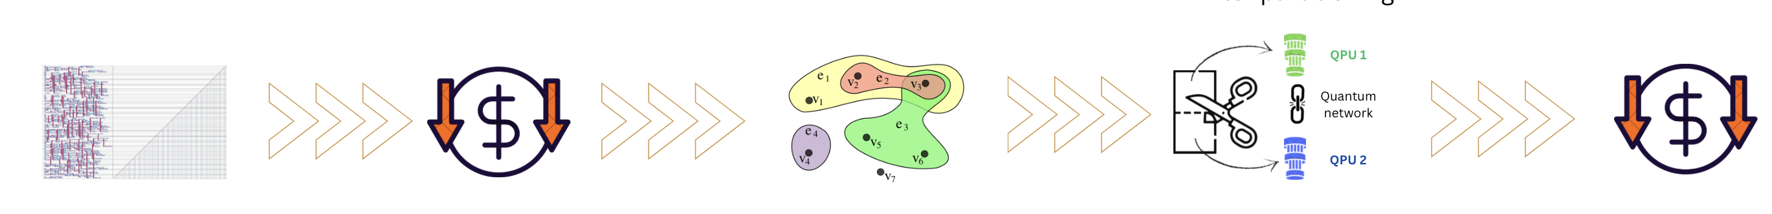
Distributed Quantum Computing (DQC)
*via a quantum network
Multiple quantum computers interconnected* to perform a joint computation larger than their individual capacities.
Large computation
Abstraction
Partition for Assignment
to QPUs in the network
On the Distortion of Partitioning Performance by Random Quantum Circuits, Maria Gragera Garces, ICDCS DisQIC 2026

Slide 4
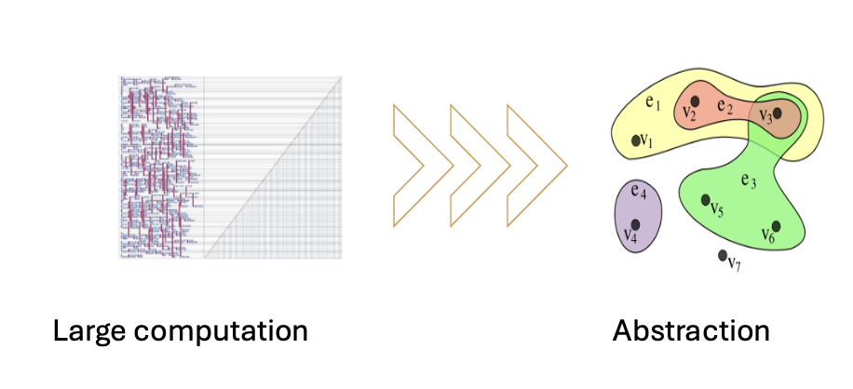
What abstraction?
Qubit -> vertex, Gate -> Hyperedge
On the Distortion of Partitioning Performance by Random Quantum Circuits, Maria Gragera Garces, ICDCS DisQIC 2026

Slide 5
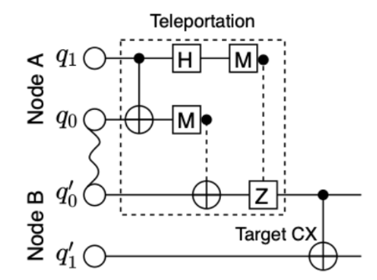
What abstraction?
Qubit -> vertex, Gate -> Hyperedge
AFTER PARTITIONING
Non local gates (hyperedges across partitions) are implemented through Teleportation or CAT primitives:
Non-local TP CNOT
Figure taken from arxiv: 2207.11674

Slide 6
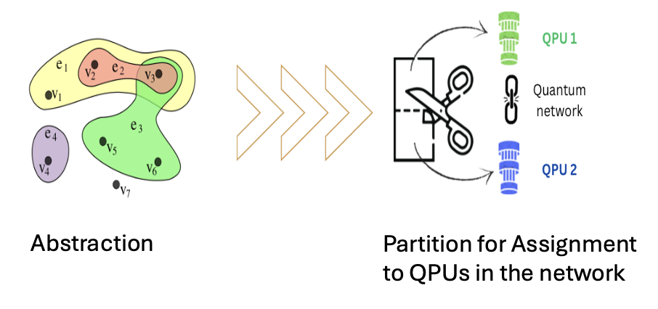
How do we partition?
Hypergraph partitioning solvers.
On the Distortion of Partitioning Performance by Random Quantum Circuits, Maria Gragera Garces, ICDCS DisQIC 2026

Slide 7
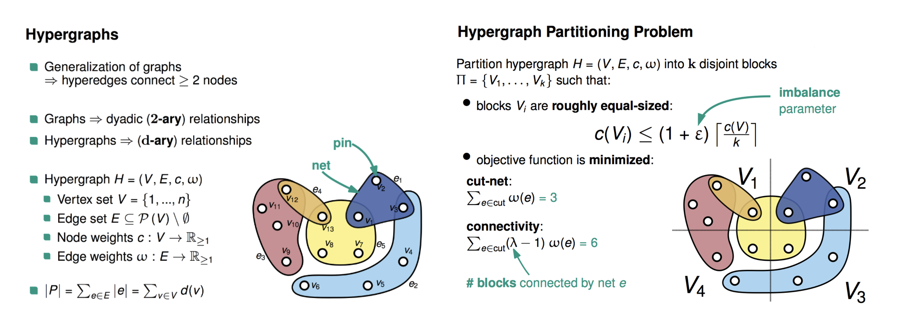
How do we partition?
Hypergraph partitioning solvers.
INPUT
Figure taken from kahypar.org

Slide 8
How do we partition?
Hypergraph partitioning solvers.
Figure taken from kahypar.org

Slide 9
How are partitioners evaluated?
EPR pairs consumed
Do we beat state of the art?
Number of qubits
On the Distortion of Partitioning Performance by Random Quantum Circuits, Maria Gragera Garces, ICDCS DisQIC 2026

Slide 10
How are partitioners evaluated?
EPR pairs consumed
Do we beat state of the art?
What circuits we ask this question over matters.
Number of qubits
On the Distortion of Partitioning Performance by Random Quantum Circuits, Maria Gragera Garces, ICDCS DisQIC 2026

Slide 11
The structure of partitioned hypergraphs will lead to some partitioning techniques being better than others over those structures.
Theory
On the Distortion of Partitioning Performance by Random Quantum Circuits, Maria Gragera Garces, ICDCS DisQIC 2026

Slide 12
The structure of partitioned hypergraphs will lead to some partitioning techniques being better than others over those structures.
Theory
Choosing representative baselines (circuits/hypergraphs) that represent real algorithms is important for evaluating partitioners?
Yet…
On the Distortion of Partitioning Performance by Random Quantum Circuits, Maria Gragera Garces, ICDCS DisQIC 2026

Slide 13
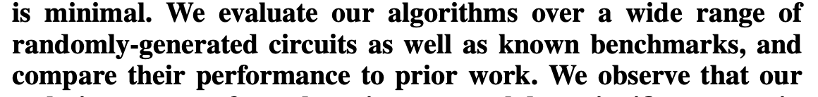
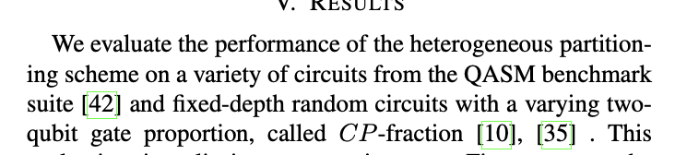
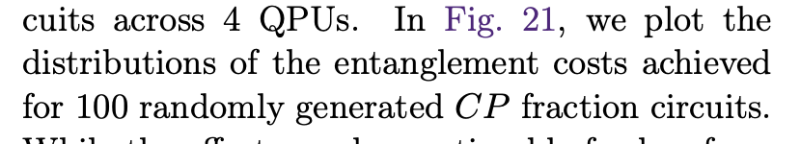
arxiv 2306.00195
arxiv 2507.16036
& many others…
arxiv 2503.19082
On the Distortion of Partitioning Performance by Random Quantum Circuits, Maria Gragera Garces, ICDCS DisQIC 2026

Slide 14
The experiment
On the Distortion of Partitioning Performance by Random Quantum Circuits, Maria Gragera Garces, ICDCS DisQIC 2026

Slide 15
Experimental setup
3 Hypergraph origins
Real algorithms (MQT Benchmark suite & Quipper algorithms) -> Quantum circuits -> Hypergraphs
Random circuits (Qiskit random circuit functions) -> Hypergraphs
Generated circuits / Programmatically instantiation well-known quantum algorithms (QGEN) -> Hypergraphs
On the Distortion of Partitioning Performance by Random Quantum Circuits, Maria Gragera Garces, ICDCS DisQIC 2026

Slide 16
Experimental setup
3 Origins
Partitioners
Random partitioner: assigns each vertex independently and uniformly to one of the k blocks.
Greedy partitioner: for each hyperedge, unassigned vertices are placed in the block that already contains the majority of that hyperedge’s vertices.
Stochastic Greedy partitioner (StochG): extends the greedy approach with randomised restarts and local improvement.
Fiduccia-Mattheyses (FM): C. M. Fiduccia and R. M. Mattheyses, “A linear-time heuristic for improving network partitions,” in Papers on Twenty-five years of electronic design automation, 1988, pp. 241–247.
KaHyPar: S. Schlag et al., “High-quality hypergraph partitioning,” ACM Journal of Experimental Algorithmics, 2023
Zoltan PHG: K. D. Devine, E. G. Boman, R. T. Heaphy, R. H. Bisseling, and U. V. Catalyurek, “Parallel hypergraph partitioning for scientific computing,” in Proceedings 20th IEEE International Parallel & Distributed Processing Symposium. IEEE, 2006, pp. 10–pp.
Evolutionary partitioner (EA): represents each solution as a vertex-to-block assignment and evolves a population of balanced partitions using tournament selection, uniform crossover with balance repair, and capacity-constrained mutation.
Real
Random
Generated

Slide 17
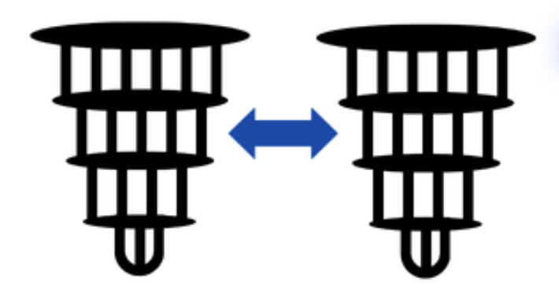
Experimental setup
3 Origins
7 Partitioners
2-10 partitions
Random
Greedy
StochG
FM
KaHyPar
Zoltan PHG
EA
Real
Random
Generated
…
…

Slide 18
Findings
On the Distortion of Partitioning Performance by Random Quantum Circuits, Maria Gragera Garces, ICDCS DisQIC 2026

Slide 19
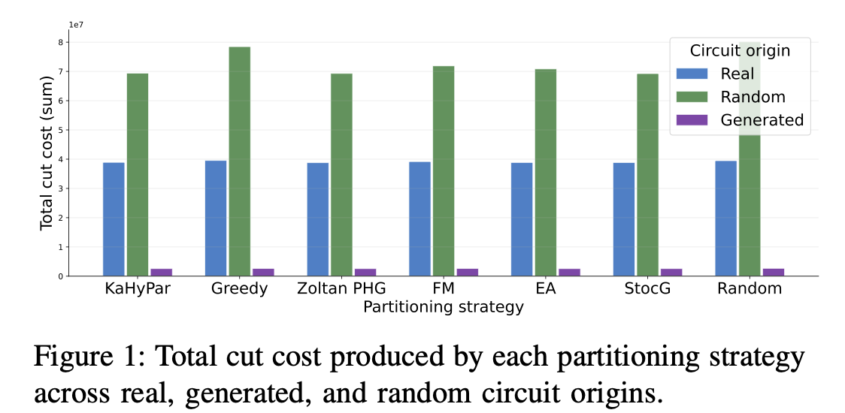
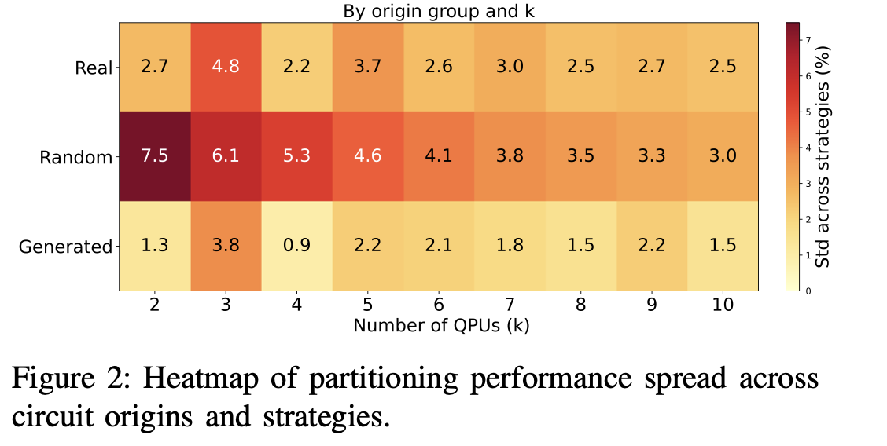
Total cost and result variance
On the Distortion of Partitioning Performance by Random Quantum Circuits, Maria Gragera Garces, ICDCS DisQIC 2026

Slide 20
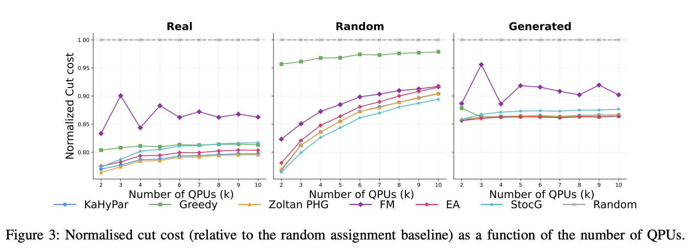
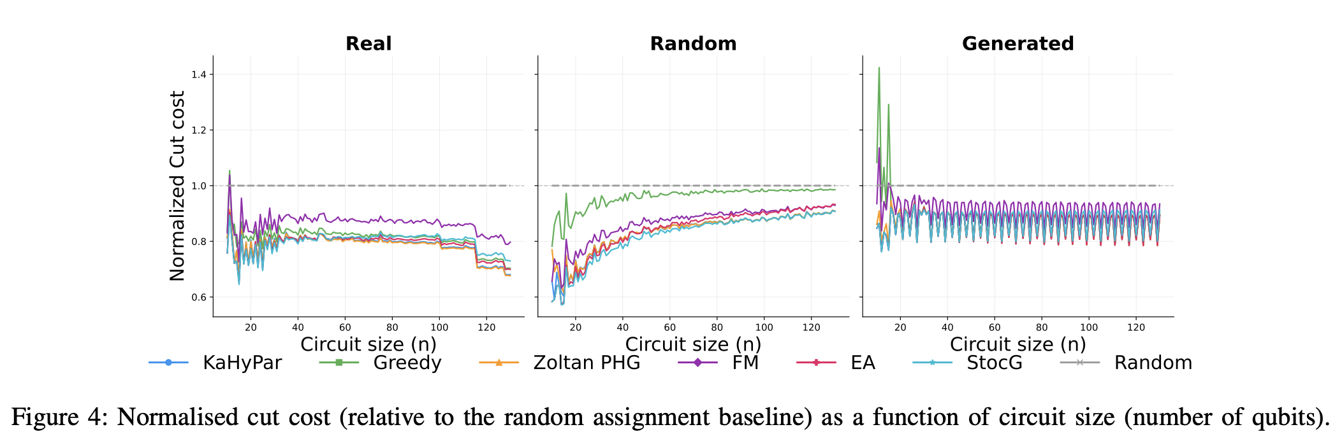
Cut cost through k and n

Slide 21
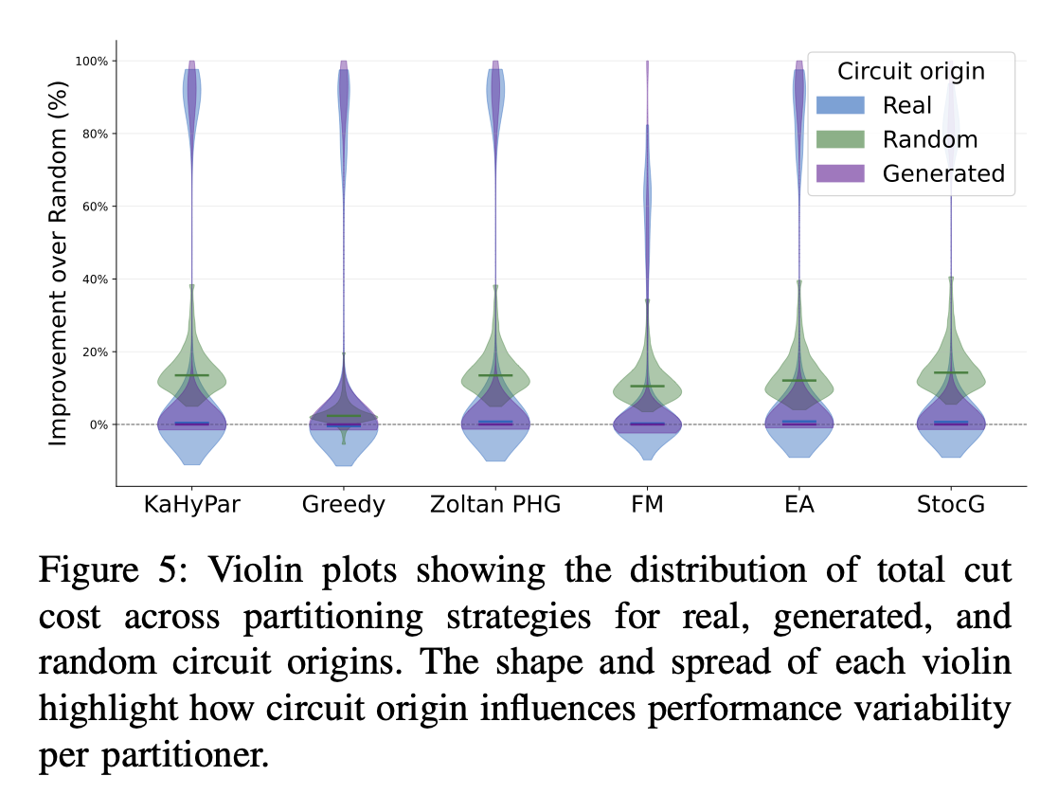
Result distributions
On the Distortion of Partitioning Performance by Random Quantum Circuits, Maria Gragera Garces, ICDCS DisQIC 2026

Slide 22
Future research
On the Distortion of Partitioning Performance by Random Quantum Circuits, Maria Gragera Garces, ICDCS DisQIC 2026

Slide 23
We can see that structure can guide hypergraph performance.
On the Distortion of Partitioning Performance by Random Quantum Circuits, Maria Gragera Garces, ICDCS DisQIC 2026

Slide 24
How can we characterise and exploit the structures emerging from DQC hypergraphs to minimize inter-QPU communication?
We can see that structure can guide hypergraph performance.
On the Distortion of Partitioning Performance by Random Quantum Circuits, Maria Gragera Garces, ICDCS DisQIC 2026

Slide 25
Thank you! Any Questions?
Takeaways
Random circuits can lead us to believe some partitioners are better than they would be in deployment.
Generated circuits can be a more accurate and scalable solution for testing.
Generated circuits can be a cheap testing benchmark.
On the Distortion of Partitioning Performance by Random Quantum Circuits, Maria Gragera Garces, ICDCS DisQIC 2026

